Slide 1
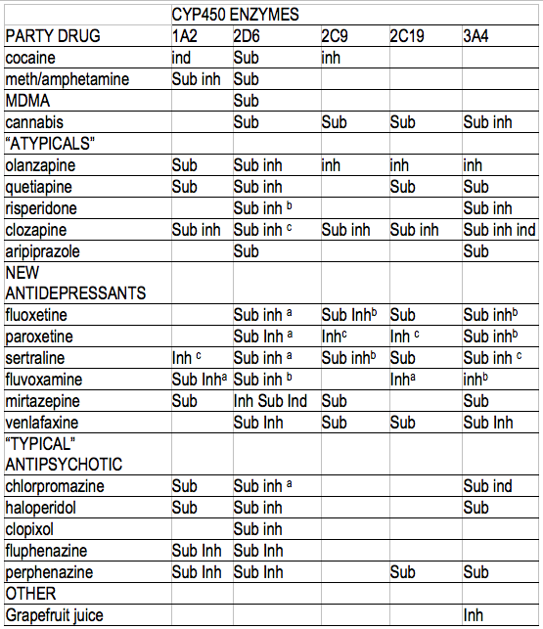
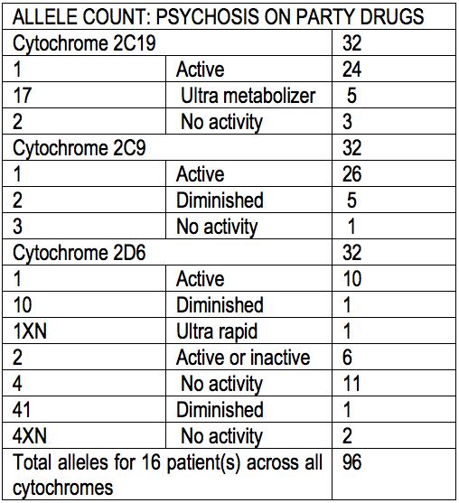
Do Illicit Street Drugs Cause Schizophrenia?
Yolande Lucire MBBS, DPM, FRANZCP (resigned) PhD & Christopher Crotty PhD
Why do some people believe that they do?*
What is the link between illicit street drug use and being diagnosed with “treatment-refractory schizophrenia”?#
Does pharmacogenetics answer these questions?
This presentation links street drugs, impaired CYP450 metabolism, atypical antipsychotics and “treatment-refractory schizophrenia.”
*Large M, Sharma S, Compton MT, Slade T, Nielssen O. Cannabis use and earlier onset of psychosis: a systematic meta-analysis. Arch Gen Psychiatry. 2011Jun;68(6):555-61
# see www.trsconsensus.com.au Targeting Treatment-Refractory Schizophrenia: A multidimensional outcomes approach to the diagnosis and management of incomplete recovery Professor Tim Lambert The Brain and Mind Research Institute.
16 persons suffering from adverse effects of “party” drugs:
Were given atypical antipsychotics and/or antidepressants
Party drugs, antipsychotics and antidepressants all interact with CYP450 enzymes as either substrates (S), inhibitors (Inh), or inducers (ind) .
All developed neurotoxic symptoms: akathisia, confusion/hallucinosis, delirium.
All but 1 (who had 2C19*17) had impaired CYP450 metabolism due to variant CYP450 alleles. See chart ➔
All 16 eventually received a diagnosis of “treatment-refractory schizophrenia.”
The toxidrome first manifested because of impaired CYP450 metabolism for party drugs
CYP450 Metabolism of atypicals, SSRIs and illicits
ª weak, ^{b} intermediate and ^{c} strong inhibition. Weak inhibitors are strong in high doses
Sources: Wynn GH, Oesterheld, JR Cozza, K Armstrong SC Clinical Manual of Drug Interaction Principles for Medical Practice. American Psychiatric Publishing Inc 2009.
Supercyp website: http://bioinformatics.charite.de/supercyp/
Piatkov et al 2009, compared CYP450 variant allele incidence in a sampled population, our akathisia patients, and those in drug clinics.
Several other studies in drug clinics show a similar increased incidence of multiple mutations.
Drug users who have become psychotic and attend clinics are likely to have impaired drug metabolism.
The likelihood of multiple CYP450 mutations makes CYP450 worth investigating in substance-induced conditions. In any case
It makes no sense to treat a toxic state with medicinal toxins which demand the same metabolic pathways.
And also inhibit them
THE TOXIC PSYCHOSES | THE FUNCTIONAL PSYCHOSES
akathisia, restlessness, obsessive preoccupation with death, dying, and suicide, inexplicable impulse to kill people one most loves, violence, behavioural dyscontrol, confusion/ambulant delirium, manic shift, weird violent dreams, insomnia, Sick, vomiting, racing heart, loss of coordination, cognitive impairment memory problems. Confabulations, shifting false reports, misinterpretation, serotonin toxicity or neuroleptic malignant syndrome | absent causation. clear sensorium, absent confusion. absent physical / neurological disease. absent substance/medication use. specific voices 3rd party or conversation. fixed delusions, correctly defined. mania or depression.
ICD F10 - F19 MENTAL AND BEHAVIOURAL DISORDERS DUE TO PSYCHOACTIVE SUBSTANCE USE PROMINENT: CONFUSION, LACK OF COORDINATION MEMORY/COGNITION IMPAIRED | ALL “FUNCTIONAL PSYCHOSES” CARRY THE EXCLUSION “NOT CAUSED BY SUBSTANCE OR MEDICATION” ABSENT: CONFUSION, LACK OF COORDINATION, OTHERWISE CLEAR THINKING
333.99 Neuroleptic and SSRI- Induced Akathisia 292.81 Substance - Induced Delirium 292.84 Substance – Induced Mood Disorder 292.83 Substance- Induced Persisting Amnesic Disorder/Dementia 292.11 Substance - Induced psychotic disorder, with delusions/hallucinations 995.2 Adverse Effects of Medication NOS | 295 Schizophrenia 295.40 Schizophreniform Disorder 297.1 Delusional Disorder 298.8 Brief Psychotic Disorder 296 Manic Episode 296 Major Depressive Episode
The burden on mental health from these 16 alone is massive. We submit that.....
Knowledge of pharmacogenetics
Knowledge that diminished metabolism is not rare, causes toxicity and warrants special care
Application of exclusion criteria for drug induced toxicity before diagnosing mental illness
Can reverse this misdiagnosis problem and save millions in mental health care costs
And effect cures
These 16 patients needed a drug detoxification service, not more toxins.
Instead they got, unlawfully, on the Pharmaceutical Benefits Scheme, for no payment, “not TGA or FDA approved,” i.e. “off label,” hugely hyped, atypical “antipsychotics,” which used up residual CYP450 metabolic capacity while some inhibited CYP450 3A4 even more.
Atypicals have never been approved for drug-induced psychoses.
Because they have not been tested for it, or have been found to be ineffective or harmful
On the basis of the history of 16 cases, investigated with history and CYP450 testing:
Illicit “party” drugs do not cause schizophrenia.
Party drugs cause side effects which are toxic psychoses.
“Treatment refractory schizophrenia” is a toxic psychosis caused by treatment in a person who cannot metabolize psychiatric drugs.
Impaired CYP450 metabolism + amphetamine, MDMA, or cocaine + cannabis toxicity
Interactions are made worse by giving more drugs metabolised by CYP450. Cannabis, risperidone and olanzapine all inhibit the “sink” enzyme CYP450 3A4 which should pick up metabolism if others are defective.
Party drugs are all metabolised by CYP450 with 2D6 being common to all. Risperidone, olanzapine and quetiapine are metabolised by CYP450 2D6.
Risperidone, olanzapine and haloperidol all inhibit CYP450 3A4. Chlorpromazine also inhibits 2D6 but not 3A4.
Defective CYP2C9 (*2) (2/16) was associated with cannabis toxicity (psychosis)/withdrawal psychosis
Non-recovery from party drugs was not known in the 1960s, 70s and 80s when party drug induced states were treated with masterly inactivity.
Nor was “treatment refractory schizophrenia” known.
Cannabis is stronger now. Is inhibition of 3A4 stronger too?

