Slide 1
The Australian Academy of Forensic Sciences
Plenary Session May 16, 2018
From Personalized Medicine to Personalized Justice: the promises of translational pharmacogenomics in the justice system
Dr Yolande Lucire
PhD MBBS DPM FRANZCP (1970-2011)

Slide 2
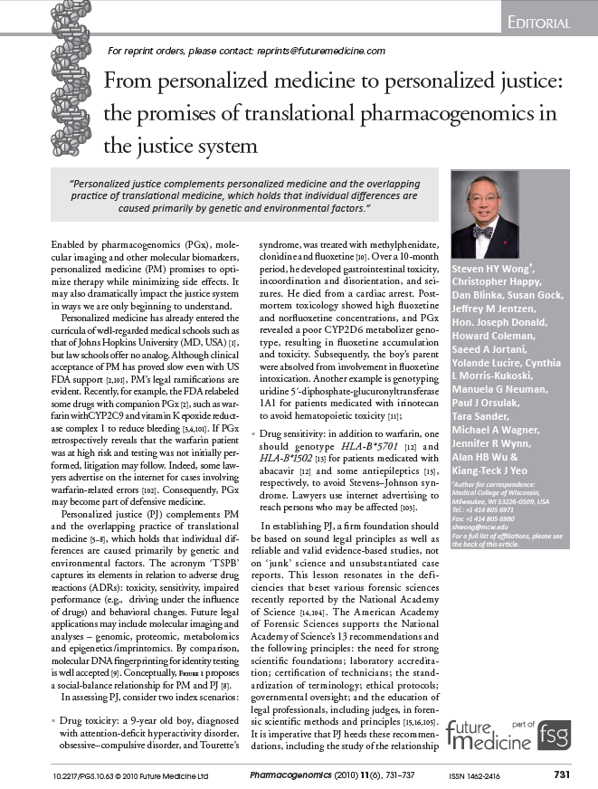

Slide 3
Lucire & Crotty's 2011 Akathisia Homicides
We examined the pre-medication history of 85 persons;
Who had developed suicidal and/or homicidal ideation and acts;
Only after being prescribed antidepressants for stressful human events;
Worrying about something having been bullied, having been sexually abused, marital problems, and for being substance abusers.
75 of them definitely had no mental illness before medication. We were unable to get information for ten of them.
We tested for 25 alleles of the cytochrome P450 metabolizing genes and compared our results to a medical population in central Melbourne.
We hit research gold dust. Akathisia subjects had so many more times as many defective alleles than the medical population, a result that could have happened by chance in one in 6000 studies.

Slide 4
Tonight I will introduce you to
The principles of pharmacogenetics (PGX)
Literature on catastrophic adverse effects that psychiatric medication has for some people
The magnitude and enormity of the problem
How it came about through drug company fraud, conspiracy and corruption
The utility of PGX in the courts
Some examples of the explanatory power of PGX

Slide 5
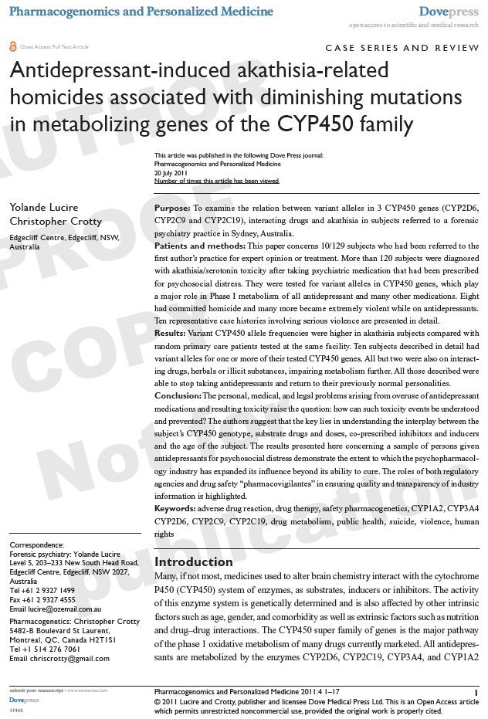

Slide 6
PRINCIPLES OF PHARMACOGENETICS
Pharmacogenetics is the study of genetic differences in drug metabolic pathways.
‘Forensic’ comes from the Latin, Forens (the forum), which is where the law courts are. It has come to mean “detailed and scholarly.”
Pharmacogenetics has explanatory power, so forensic usefulness.
“Pharmacogenetics psychiatry” gets 32,000 hits on Google Scholar. 36 are mine.
“Forensic pharmacogenomics” gets 3,600 hits.
It is is researched at many Australian universities.
80 % of exotoxins and 60% of drugs used in psychiatry are metabolised by the cytochrome P450 system in which there is a
1000-fold variation in metabolism between individuals.

Slide 7
PRINCIPLES OF PHARMACOGENETICS
Genes encode enzymes. Not everyone has all the genes and all the enzymes.
Each drug is metabolised preferentially by an enzyme, but if that is unavailable or inhibited by a co-prescribed drug, others are promiscuous.
All enzymes are important.
Adverse drug reactions such as suicide and violence occur with levels over the “therapeutic window of opportunity” as well as;
Sudden changes up or down
So starting and stopping are danger periods

Slide 8
GENETICALLY DETERMINED ENZYMES METABOLIZE TOXINS AND MEDICINES.
In 2003, Dr Allen Roses, while Senior Vice President of Genetics at GlaxoSmithKline stated in public:
“90% of drugs only work in 30%-50% of people.”

Slide 9
GENES
A gene is made of two alleles, one each from mother and father.
Genes encode enzymes that break down medicines (toxins) so the body can get rid of them. The enzyme is released from the DNA strand.
Not everyone has all the genes and all the enzymes.
The majority of us have some “defective” metabolizing alleles which make some drugs, but not others, problematic for different people.
Pharmacogenetics was established as a discipline in the 1960s.
Test (SWAB) at NSW Health and MyDNA in Melbourne for less than $100.

Slide 10
The patient’s genotype is the formerly invisible factor that explains why some people react badly to doses and combinations and others do not.
Living and dead patients with medication-induced problems appear in every civil and criminal jurisdiction.
Major Use of this evidence: Deflecting medical negligence cases onto the pharmaceutical industry which has failed to warn and educated negligently.
In USA, both doctor and Drug Company are sued. Doctor side steps, takes the “learned intermediary defense:” “I was not told, I have been lied to.”
Defense of medical negligence
Suicide
Homicide
Differentiating mental illnesses from toxidromes for treatment
Damages to survivors of attacks
Inability to work
Professional Tribunals
Mental Health Review Tribunals;
Common & family law
Workers compensation
Death of wage earner
Lower & higher criminal court for weird behaviours
Behavioural changes due to confusion

Slide 11
APPRENTICE, 21, Back Injury: Oxycodone, NSAIDS for back injury & Zoloft (sertraline) 400 Mg/day
Hospitalised after violence against his parents, consistent with medication-induced akathisia from high dose Zoloft, smoking tons.
Day 1 Zoloft 600 mg, (accidentally) and 5 mg of oxycodone.
Day 2, Zoloft 400 mg, oxycodone increased to 10 mg (8 X standard dose).
Day 3 Zoloft 400 mg, morphine 15 mg, added oxycodone increased to 25 mg + 20 mg metoclopramide (Maxolon).
Day 4 Zoloft 400 mg, morphine 20 mg, oxycodone 20 mg.
Day 5 Zoloft 200 mg, morphine dose illegible, Oxycodone 20 mg.
Day 6 collapsed with normal heart rate and blood pressure.
Did not breathe for 8 minutes. Emerged with brain injury.
Complaint went to a Tribunal. Three experts a side and everyone was exonerated. But was the public protected?

Slide 12
GENOTYPES 2D6*1*2, 2C9*1*1, 2C19*1*17
Hydrocarbons in cigarettes induce all CYP450 enzymes. Inducer removed on admission. Medications levels tend towards rise.
Oxycodone is a pro-drug and requires enzyme CYP450 2D6 to convert it to morphine.
Not him, but 10% of Caucasians lack 2D6 and get no benefit from pro-drugs. Zoloft: mild inhibitor of 2D6 but inhibition is dose dependent.
400 mg/day is 8 times standard dose (50 mg).
Zoloft (sertraline) inhibits 2D6, so oxycodone does not convert.
Zoloft (sertraline) dose was reduced fast and stopped over 5 days.
2D6 disinhibited: accumulated pro drug converts to morphine causing respiratory arrest.
Parents saw similarity with Health Ledger’s death: prodrug metabolites in his blood caused coroner to rule an accidental overdose. Empty Zoloft packet in the house.

Slide 13
THIS EXAMINATION DEMANDS
No Autopsy
Manner of event, death, hanging, single car, usually violent
Blood levels toxicology, metabolites ASAP
Pharmacogenetic testing for CYP450 by swab
Mental health and medication records
Psychological autopsy
Interviews with relatives seeking akathisia, serotonin toxicity and effects on other organs.
Premedication diagnosis
Reasons for first medication
Medication changes, additions and reasons
Familiarity with CYP450-based adverse drug reactions and interactions

Slide 14
MULTIPLE EXPERTS ARE USUALLY REQUIRED
Television pathologists Harrow, Nikki and Harry would conduct all these interviews with families, and others.
Psychological autopsy reconstructs what the person thought, felt, and did before the event, death or suicide attempt.
Investigation by a person trained to identify the criteria of mental illnesses, familiar with prescriber information, and the correlates of drug toxicity on brain and all organ systems.
See expert evidence in 4 trials 'Let them Eat Prozac' Website
http://www.healyprozac.com

Slide 15
GETTING PREMEDICATION DIAGNOSIS RIGHT
Differentiating toxic psychoses, caused by substances or medications
from the mental illnesses they suggest or mimic,
Is the most important diagnosis one makes in psychiatry.
The correct treatment for one is catastrophic for the other…
All mental illnesses listed in the DSM and ICD carry a diagnostic exclusion clause:
The disturbance is not due to the direct physiological effects of a substance (e.g., a drug of abuse, a medication) or a general medical condition.

Slide 16
MENTAL ILLNESSES
295 Schizophrenia
295.40 Schizophreniform Disorder
297.1 Delusional Disorder
298.8 Brief Psychotic Disorder
296 Manic Episode
296 Major Depressive Episode
Obsessive compulsive disorder
Generalised and specific anxiety disorders
All mental illnesses listed in the DSM carry a diagnostic exclusion clause:
The disturbance is not due to the direct physiological effects of a substance (e.g., a drug of abuse, a medication) or a general medical condition.

Slide 17
SUBSTANCE/MEDICATION-INDUCED DISORDERS IN DSM-5
Antidepressant discontinuation syndrome
Medication-induced Acute akathisia
Medication-induced Acute dystonia
Medication-induced delirium
Medication-induced Parkinsonism
Medication-induced Postural tremor
Medication-induced Tardive akathisia
Medication-induced Tardive dystonia
Neuroleptic malignant syndrome
Other medication-induced movement disorder
Not in DSM but should be:
Medication-induced withdrawal akathisia
Medication-induced delayed post withdrawal akathisia
*Potentially fatal conditions in bold
Serotonin Syndrome
Substance-induced addictive disorders
Substance/Medication-induced anxiety disorder
Substance/Medication-induced bipolar & related disorder
Substance/Medication-induced delirium
Substance/Medication-induced depressive disorder
Substance/Medication-induced neurocognitive disorder
Substance/Medication-induced obsessive-compulsive & related disorders
Substance/Medication-induced psychotic disorder
Substance/Medication-induced sexual dysfunction disorder
Substance/Medication-induced sleep disorder

Slide 18
Substance/medication- induced: mimics
Addictive disorder
Bipolar & related disorder
Depressive disorder
Neurocognitive disorder
Obsessive-compulsive disorder
Psychotic disorder
Sexual dysfunction disorder
Sleep disorder
Like hysteria, organic brain syndromes are a great imitator.
Paradigm case - neurosyphilis:
Different in every patient & on each presentation.

Slide 19
EPIDEMICS ARE EITHER INFECTIOUS OR IATROGENIC, (CAUSED BY TREATMENT)
“PharMA Science” or mental illness with adverse drug reactions?
Beat ups about the high prevalence of depression.
“In the Australian Mental Health Survey, 4% of adults had a depressive disorder in the past month.”
For funding purposes Mental Health covers substance abuse and medication induced disorders.
Unrecognized side-effects fill hospitals and prisons with non-recovering patients who have sublethal conditions, recurrent suicidality, episodic violence and pseudo-dementia.
Psychiatric disability is now the leading cause of disability pensions in Australia.

Slide 20
SMH - Matt Wade, June 2013. Mental illness costing $190b a year
Gruen Lateral Economics 2013
The cost of mental illness to Australia's collective wellbeing reached $190 billion a year - equivalent to about 12 per cent of the economy's annual output.
I last read $200 billion?
Demand for mental health care (and costs) doubled in decade from 1990 and quadrupled since new generation drugs
Mental Health advocates demand more resources, & more doctors to prescribe more drugs

Slide 21
TEXAS MEDICATION ALGORITHM PROJECT
Texas Medication Algorithm Project (TMAP) was a consortium of PharMA's that promoted “NEW GENERATION” drugs by “endorsement science.”
TMAP commissioned draft Clinical Practice Guidelines for Australia (US and UK) to be signed, endorsed by “Key Opinion Leaders.”
TMAP has been sued for fraud.
The citation base of Guidelines bears no relationship to their text.
FALSE CLAIMS ACT litigation in USA reaps billions for taxpayers & millions for whistle blowers
GUIDELINES have been accepted by institutions as “evidence.”
RANZCP, a professional association, has been declared to be “the expert” by our regulators.
Expert - a person who is very knowledgeable about or skillful in a particular area.

Slide 22
What is an ALGORITHM? A set of rules to be followed in calculations, by a computer.
CLINICAL PRACTICE GUIDELINES RECOMMEND ALGORITHMIC DOSES, AVERAGES
For example:
I have my hand on a burning hot plate,
I have my feet in a bucket of iced water,
and, on the average,
I am quite comfortable.
Metabolism varies 1000-fold between individuals in any population.
An algorithmic dose would rarely be right.
An Algorithm is an obscenity when applied to a dose of medicine

Slide 23
TMAP IN THE REAL WORLD
“Algorithms” assume the patient to be an extensive metabolizer, not taking other medications.
Only 9 % of my 250 gene-tested subjects were not taking something else when an antidepressant was prescribed. (Alcohol, herbs, pain meds, party drugs, hormones).
Guidelines recommend drugs in doses and combinations that set up a quagmire of drug-drug interactions
They contain no warnings of medication-induced sucidality, violence, or aggression, nor of effects on all organ systems.
They contain no warnings of withdrawal difficulties or “addiction.”
They contain very few examples of interactions.
They are silent about defective metabolizers.
If prescribers follow guidelines, patients get polypharmacy.

Slide 24
US FDA Public Health Advisory, March 22, 2004 WORSENING DEPRESSION AND SUICIDALITY IN ADULTS AND CHILDREN BEING TREATED WITH ANTIDEPRESSANTS
Health care providers should carefully evaluate patients in whom depression persistently worsens, or suicidality is severe and not part of the presenting symptoms, to determine what intervention, including discontinuing or modifying the current drug therapy, is indicated.
Anxiety, agitation, panic attacks, insomnia, irritability, hostility, (homicidal thinking), impulsivity, akathisia (severe restlessness), hypomania, and (medication-induced) mania have been reported in adult and pediatric patients being treated with antidepressants for major depressive disorder as well as for other indications, both psychiatric and nonpsychiatric.
Suicidality with antidepressant medication bears NO relationship to psychiatric diagnosis. The drug is in the body and impacts on brain affecting the MIND.

Slide 25
“FAILURE TO WARN” AND NEGLIGENCE
The High Court of Australia has determined:
“A doctor has a duty to warn a patient of a material risk inherent in the proposed treatment;
A risk is material if, in the circumstances of the particular case, a reasonable person in the patient’s position, if warned of the risk, would be likely to attach significance to it or if the medical practitioner is or should reasonably be aware that the particular patient, if warned of the risk, would be likely to attach significance to it.”
QUESTION:
Does a drug company that provides state-approved education programs have the same duty?

Slide 26
INSTITUTIONAL RESPONSE TO FDA Suicide Warning for Prozac March 25, 2004
Dr. Bill Lyndon, who chairs the psychotropic drugs committee of the Royal Australian and New Zealand College of Psychiatrists, said he welcomed any move that raised awareness about SSRIs and encouraged caution.
"I'm aware of a link between SSRIs and suicidal thoughts in adults, as well as adolescents, but the evidence is not conclusive," Dr Lyndon said.
"These are valuable drugs, and it would be a disaster if people were to stop using them.”

Slide 27
THE PRECAUTIONARY PRINCIPLE
All grist for the legal mill?
The College still advises that the science underpinnings of 8 more Public Health Advisories about sucidality etc is “inconclusive.”
The College and its members still deny side effects listed in Product Information.
No NEW GENERATION drug has been “approved” for kids (with tiny exceptions), as
Safety and efficacy have never been established.
“Useful drugs for children” says the College of Psychiatrists.
Early Psychosis Prevention and intervention Centre (EPPIC) Guidelines (Headspace) recommend 9 drugs for kids that have never been approved by FDA.
In 2005, HCC Commissioner decided not to accept that medicines induced suicide and violence because it was “not yet psychiatric orthodoxy.”

Slide 28
THE ENORMITY & MAGNITUDE OF THE PROBLEM
USA: Andrea Yates, on the antidepressant Effexor. Drowned five children in 2001 saying Satan had commanded her in order to save them. A warning about “homicidal ideation” was added to the Efexor label, but only in USA. NOT IN AUSTRALIA. Huge differences in product information between USA and Australia.
Princess Diana cut her wrists and threw herself down the stairs while on Prozac.
Michael Hutchence on Prozac (fluoxetine) 60 mg) and Rene Rivkin, (Aropax 60 mg) both on huge doses, committed suicide.
Actor Robin Williams hanged himself on antidepressants and polypharmacy after many attempts. The Coroner’s Report described his akathisia with restlessness like the textbooks. No one joined the dots.
Pilot of Lufthansa German Wings who crashed a commercial flight deliberately into a mountain had long history of unsuccessful antidepressant treatment and polypharmacy.
Should coroners be the canaries in the coalmine?

Slide 29
Akathisia Events SSRI STORIES: ANTIDEPRESSANT NIGHTMARES www.ssristories.com
More than 6000 accounts, from 1966
Collated from newspapers, TV, and scientific journals
Thousands of suicides
Weird behaviours
Antidepressant-induced massacres, homicides, and school shootings
Along with the drugs that were in use, which were mostly antidepressants and psychostimulants, ADHD drugs), and
Some legal defences

Slide 30
ABS 4329.0.00.006 - Mortality of People Using Mental Health Services and Prescription Medications, Analysis of 2011 data
At the instigation of the National Mental Health Commission, the Australian Bureau of Statistics in September 2017 published that,
In 2012, 14.8% of the population
Had accessed mental health services and
Had been dispensed one or more of the five groups of mental health drugs on the Pharmaceutical Benefits Scheme

Slide 31
14.8 % OF THE POPULATION IN 2012 accounted for
49.6% of the deaths (n=153,451) in age range 15-75.
52% of the suicides (n= 2,295).
That is, 75,000 deaths and 1145 suicides were associated with the use of psychiatric drugs.
Three times as many ex-servicemen have committed suicide since coming home than died in Afghanistan.
The absolute number of suicides in Australia increased by 732 between 2012 and 2016, well in excess of the population increase.
EPIDEMICS ARE EITHER INFECTIOUS OR IATROGENIC, i.e. CAUSED BY TREATMENT

Slide 32
MOST NOT MENTALLY ILL BEFORE DRUGS DEMAND AND COSTS QUADRUPLED
Schizophrenia affects 1% of the community, intermittently, across cultures and decades.
Bipolar affects 0.5% across cultures and decades. 10% of American children get that diagnosis and pills to match.
The suicide rate was 38.0/100,000 people who had accessed MBS and/or PBS mental health-related services or medications. This is three times the population rate.
17/100,000 in the bush where psychiatrists are in short supply.
Suicidality at three times the placebo rate showed up in the clinical trials presented for the “approval” of antidepressants.
Suicidality was six times placebo rate in trials that got atypical antipsychotics approved.
Zyprexa was the most suicidogenic drug in the history of clinical trials with Risperdal not far behind.

Slide 33
SUICIDE BY PATIENTS BEING TREATED BY NSW HEALTH MENTAL HEALTH
In the 10 years, 1993 to 2002, counted within 28 days of contact:
1290 persons treated in NSW public mental health care committed suicide: Average 129 a year.
In 2002 NSW Health changed the mode of counting but the numbers got worse.#
In the 6 years, 2003 to 2008, counted within 7 days of contact:
937 persons treated in NSW public mental health care committed suicide: Average 156 a year.
2227 persons committed suicide between 1993 and 2008, in 16 years under NSW care mental health care where these drugs were being prescribed or changed, an average of 139 a year
*NSW Parliament Question asked on 13 May 2010 (session 54-1) and published in Questions & Answers -1613/www.health.nsw.gov.au/pubs/2009/pdf/2nd_report.pdf

Slide 34
1993-2002 - Suicides committed within 28 days of contact with NSW Mental Health Services
Year | Suicides in NSW | Suicides in mental health care | % of all NSW suicides
1993 | 676 | 68 | 10%
1994 | 798 | 72 | 9%
1995 | 747 (748) | 100 | 13%
1996 | 811 (817) | 136 | 17%
1997 | 946 (950) | 166 | 18%
1998 | 827 (832) | 143 | 17%
1999 | 846 (854) | 173 | 20%
2000 | 738 | 156 | 21%
2001 | 775 (789) | 159 | 21%
2002 | 643 | 117 | ?

Slide 35
HOMICIDE BY PATIENTS BEING TREATED BY NSW MENTAL HEALTH
In the 10 years, 1993 to 2002, counted within 28 days of contact:
36 patients being treated in the New South Wales Mental Health public sector committed homicide, 3.6 a year.
NSW changed the mode of counting# but numbers got worse.
In the 6 years, 2003 to 2008, counted within 7 days of contact:
43 patients being treated in the New South Wales Mental Health public sector committed homicide.* 7 a year
79 committed homicide in 16 years, an average of 5 a year, killing friends, family members, nurses and health care workers.
# Sentinel Events Committee report 2003) *NSW Parliament Question asked on 13 May 2010 (session 54-1) and published in Questions & -1613/www.health.nsw.gov.au/pubs/2009/pdf/2nd_report.pdf

Slide 36
Australia from these numbers
Multiply the New South Wales figures by 4 to estimate what was happening in Australian Public Sector ten years ago
Many more committed suicide and homicide on drugs prescribed by NSW Health outside of these restricted parameters

Slide 37
From the Greek =k a- meaning "not" and καθίζειν kathízein meaning "to sit" or in other words an "inability to sit.” A fluctuating, can’t-sit-down restlessness also coded as agitation or psychomotor hyperactivity. It is a symptom of drug toxicity and psychiatrists should know to reduce the dose. Poorly recognized. Clinical practice guidelines do not acknowledge this condition, so the prescriber increases the dose and adds an antipsychotic, with synergistic side-effects and interactions.
AKATHISIA: A SIGN OF DANGER

Slide 38
Neuroleptic and SSRI-Induced Akathisia in DSM333.99 since1994
Akathisia may be associated with dysphoria, irritability, aggression or suicide attempts.
Worsening of psychotic symptoms (or new ones) or behavioural dyscontrol may lead to an increase in neuroleptic medication dose, which may exacerbate the problem.
Akathisia can develop very rapidly after initiating or increasing neuroleptic medication.
Acute akathisia tends to persist for as long as neuroleptic medications are continued, although the intensity may fluctuate over time.
Prevalence of varies: 20% - 75%.

Slide 39
Akathisia
Akathisia has been associated with suicide since the 1950s
and with
homicide since 1985.

Slide 40
A COMMONWEALTH INITIATIVE: MINDFRAME
Murdoch Press will never publish adverse information about drugs (money)
Mindframe, a Commonwealth initiative, more like a D-Notice ensures that suicides and homicides are always attributed to mental illness in the press

Slide 41
AKATHISIA AND OTHER EXTRA PYRAMIDAL SIDE EFFECTS ARE MANIFESTATIONS OF DRUG TOXICITY RELATED TO CYP450 METABOLISM.#
#This 1998 paper from Pfizer provides a review of antidepressant induced akathisia and suicide and its relationship to drug metabolism.
Lane RM. SSRI-induced extra pyramidal side-effects and akathisia: implications for treatment. Pfizer Inc., New York, NY 10017, USA. Psychopharmacology. 1998;12(2):192-214

Slide 42
Four enzymes CYP2D6, CYP2C19, CYP3A4 and CYP1A2 cover 95% of variance.
The population can be divided into metabolic types
Extensive (normal or (EM)
Intermediate (IM)
Poor (PM)
Ultra-rapid metabolizers (UM)
Information source: Pharmacogene Variation (PharmVar) Consortium at www.PharmVar.org provides details and research and curated data bases

Slide 43
EXTENSIVE METABOLISERS (EMs)
Extensive metabolizers (*1*1) for each enzyme comprise about 70% of the population.
The drug is not fit for purpose for the other 30% unless the dose is tailored to metabolism.
EMs are the most common Caucasians, but rare in East Asians.
Since adopting Western medications, China, like Australia, is having an epidemic of something that looks like “mental illness.”
75% of Asians are low metabolizers
Pharmacogenetic research is advanced in China, Inner Mongolia, Bosnia and Iran but not yet made it from bench to bedside
Nor will it if Big PharMA gets its way and controls post graduate medical education

Slide 44
POOR METABOLISERS (PMs)
2 inactivating variants and no functional enzyme.
Literature is substantial and no longer controversial
Cannot clear medications and experience life-threatening ADRs.
3-10% Caucasians, 30% in Eastern Europe are PMs @ 2D6
Cannot convert prodrugs, codeine, tramadol, oxycodone, into analgesic morphine so get no benefit

Slide 45
POOR METABOLIZERS
Aropax, (paroxetine) and Prozac (fluoxetine)) are metabolized by 2D6 and inhibit it as is a host of other drugs.
Australian PI says nothing about Poor Metabolizers.
El I Lilly in USA markets Prozac Weekly for Poor Metabolizers.
Tiny dose, slow release
That’s good to know for a negligence suit against the drug company

Slide 46
ULTRA RAPID METABOLIZERS (UM)
3% of Caucasians, 20% of North Africans and Swedes
Duplication of a 2D6 enzyme or carry 2C19*17*17
Suicide and death are both caused by toxicity and sudden even daily changes up or down
Pro-drugs, opiates, are heavily implicated in deaths in UMs
If breast feeding UMs take codeine, babies can and do die.

Slide 47
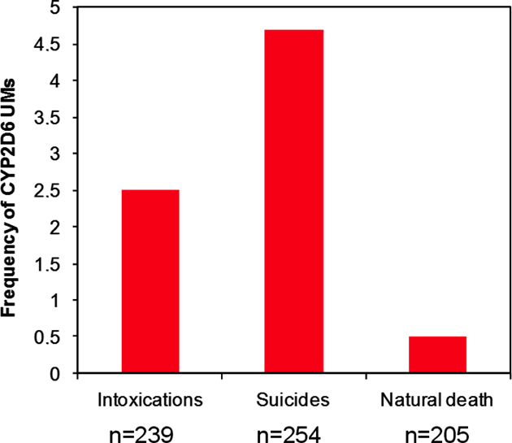
Swedish morgue studies showed that ultra rapid metabolizers at 2D6 are 15 times more likely to die from intoxication and 15 times more likely to die from suicide than EMs.

Slide 48
INTERMEDIATE METABOLISERS (IMs)
1 normal allele and 1 inactive or low.
Wide range of enzyme activity.
Some metabolize normally. Some like PMs.
IM and EM genotype subjected to an inhibitor may convert both EMs and IMs into PM phenotype over time
Strong inhibitors include methadone, Aropax, Prozac Digesic
Either strongly or mildly, all antidepressants inhibit at least one cytochrome enzyme and reduce metabolising capacity in a dose-dependent way.

Slide 49
PERSONALISED MEDICINE VERSUS EVIDENCE-BASED MEDICINE
Evidence-based medicine is based on averages. Ignores outliers.
The majority are outliers
In vitro trials of drug metabolism record positions on the X and Y axis.

Slide 50
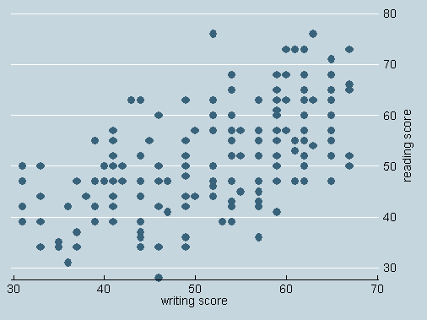
Personalised medicine
Evidence based medicine
A line shows the direction taken by these dots represents evidence-based medicine.
But which dot represents our patient?

Slide 51
WE KNOW THE DIRECTION OF CHANGE
We know the direction (not the size ) of change
The late David Flockhart, an Australian psychiatrist and leader in pharmacogenetics said:
“We don’t have a black box recorder in the body.”
We can get a medication and adverse events history
We invoke known increases and decreases in metabolism when blood levels are not available.
Occasionally someone takes blood in time to get a toxic level.
Post mortem blood levels do not correlate well with because of time lapses to sampling.

Slide 52
CYTOCHROME P450-BASED INTERACTIONS
Drug-drug interactions: compete for, slow down or speed up metabolism.
Drug-gene interactions: speed up or slow metabolism, prolonging half-life and elevate blood levels.
Drug-gene-drug interactions: as blood levels go up, inhibition or induction are increased.

Slide 53
Male 18 , CYP2D6 *4/*5, no prior history
14 day sample pack 10 mg Prozac provided because his sister was in a coma after a car accident.
A very Poor Metabolizer and under 25 (immature metabolism) *4 No activity, *5 gene deletion.
Prozac (fluoxetine) is metabolized by 2D6
Used cannabis for relief.

Slide 54
In his own words
I felt, energized, restless, no appetite, no sexual desire.
I became aggressive, paranoid, violent, could not sleep, walked around thinking constantly about suicide.
Tried to kill myself twice, tying a sheet around my neck, cutting my wrist, became depressed, and cried.
I ran out of fluoxetine and felt like a ticking time bomb… challenged strangers to fight, punched out windows, threw a toolbox through windscreen and sped, running over street signs, crashed my truck;
Stood on a bridge wanting to jump writing messages on the shattered windscreen.
Wanting to die, I walked to a friend’s house where I found a pistol, walked eight miles to my father’s house, talked. Felt small, as if watching myself from above.
I remember dad, then the sound of a gun.
No argument, no provocation.
Don’t remember pulling it out of my backpack or pointing it. Couldn’t understand what had happened. What had I done? I wanted to shoot myself. I confessed immediately.

Slide 55
This is as typical a case of acute suicidal and homicidal akathisia as you will see.
It contains all the elements.
Restlessness, kept moving
Suicidality
Toxic psychosis, delirium
Aggression, Violence
Behavioral dyscontrol
Depersonalization
Homicide
Amnesia for the event

Slide 56
Robert Whitaker, Mad In America
The madman of our nightmares is not a schizophrenic but an akathisiac, having just taken, or taken himself off, prescribed medication.#
#Whitaker, R. (2001). Mad in America: Bad science, bad medicine, and the enduring mistreatment of the mentally ill. Basic Books. Cited by 657

Slide 57
FEMALE, 35 ENGINEER, NO PRIOR HISTORY
Nortriptyline 12.5 mg/day (half dose)
IN HER OWN WORDS
… I was distressed because my husband was drinking.
I took valerian for a month and had weird dreams.
When I got nortriptyline, I immediately wanted to kill myself, never thought like that before..
I walked a lot, with palpitations, trouble breathing, and depressed. Smoked 25 a day, no alcohol.”
No sleep two nights. Then dreamt that my daughter had a a spear hanging over her head
Felt like a zombie, looking on from the outside, controlled by dark forces.

Slide 58
IN HER OWN WORDS
I believed that a bad spirit possessed her;
I had to help her.
I picked up a knife and stabbed her and woke up.
She said: “Mum, what are you doing here?”
I realized what I’d done.
I asked my husband to kill me.
He called the police.
I felt better in the police cells without the pills,
but the pills were started again and thoughts of killing myself returned

Slide 59
Mental state revealed:
Akathisia/restlessness
Suicidal ideation
Hallucinations
Depersonalization (looking on)
Insomnia
Serotonin toxicity palpitations breathing difficulties
Toxic psychosis
Manic state
Altruistic homicide

Slide 60
Pharmacogenetic explanation
She had 3 diminishing CYP450 mutations out of 6 alleles tested
CYP2D6 *4/*41, severely impaired CYP2D6 metabolism
CYP2C9 *1/*2 (intermediate metabolizer)
CYP2C19*1/*17 (ultra-rapid metabolizer) (not relevant)

Slide 61
Nortriptyline is metabolised by 2D6 and CYP3A4.
She had little 2D6 to start with and nortriptyline used up and inhibited what she had.
CYP3A4 would have been an alternate metabolic route for elimination.
But valerian had inhibited (wiped out) CYP3A4
3 days (3 doses of half standard dose) and she committed the homicide.
A warning might have saved the child.
Addition of substrate to inhibitor is one drug-drug interaction scenario (Pattern 2) described by Armstrong et al. (2003).

Slide 62
HIS OWN WORDS I couldn’t leave my house, or go to work. Anxiety was like nothing I’ve ever had before. Feelings were strange, peculiar, anger unjustified. I felt bad about it. I thought death was imminent I had an impulse to commit a violent suicide, hoping someone would kill me. Irritable with racing thoughts, like a video on fast forward. Weird, violent dreams, I drove around a lot, visiting three people in a day. Thought I was bullet-proof, god-like, a special person.
35-year-old tradesman - no prior history
20 mg/day paroxetine for relationship difficulties with former partner.

Slide 63
IN HIS OWN WORDS
My sex drive increased, then I lost interest in everything, stayed in bed, plummeted, depressed, suicidal
I met my son in the park.
His mother said:
“He’s not going with a crazy man like you.”
My last memory was getting the knife from my toolbox, walking in slow motion. A guy cracked a towel at me.
I got it wrong, where I stabbed her.
I knew I had done it because I had blood all over me.

Slide 64
Pharmacogenetic explanation 3 IM GENES CYP2D6 *2/*4 (intermediate metabolizer) (*2 is extensive) CYP2C9 *1/*2 (intermediate metaboliser) CYP2C19 *1/*2 (intermediate metabolizer)
Paroxetine is metabolized by 2D6 and 3A4 inhibits both
Therapeutic window is 70-120ng/mL Average half life 22 hours Paroxetine inhibits 2D6 irreversibly over time, leaving no 2D6 activity.
Other metabolic pathways become important as paroxetine overwhelms CYP2D6.
Paroxetine also inhibits 2C9 and 2C19, where he had diminished capacity to start with, and 3A4, and soon had virtually none
No alcohol, cannabis or other 3A4 inhibitor.
He killed in an state of non-insane automatism secondary to chemical lobotomy, following a psychological blow after 11 weeks of akathisia, caused by paroxetine toxicity
.

Slide 65
SUBJECT 5 Male (AGED 16) girlfriend had left him
COMMUNICATED BY LETTER
In a group home, struggling at school
Prescribed sertraline (unknown dose) and became “agitated, anxious, obsessive, impulsive and self destructive.”
Hospitalised, he became violent, irrational, self-mutilating, writing pages of escape plans, thinking of destroying property and designing weapons.
Feverish, angry and fearful, losing track of time, having no will power, and losing his memory.
He had palpitations and tremors (serotonin syndrome) on sertraline and violent impulses to hurt himself and others, and he made a suicide attempt.

Slide 66
Switched to fluoxetine, 20 mg/day, and attempted suicide again.
Fluoxetine was increased to 40 then 60 mg/day. 3 X standard
He became restless, energetic, and labile, and pitted himself against his family and therapist.
Valproate was added and increased to 1,000 mg/day. 5X standard
After 11 weeks in hospital, he killed his therapist and set the ward on fire.
He recovered fully upon withdrawal of psychiatric drugs.

Slide 67
MENTAL STATE EVALUATION REVEALED
Akathisia suicidality;
Anxious, obsessive, impulsive and self destructive;
Angry, irrational, energetic, labile;
Violent impulses to hurt others;
Suicide attempt;
Serotonin toxicity:
Palpitations and tremors

Slide 68
Genotypes: CYP2D6 *1/*6 (IM), *6 is ”no activity”
Prozac (fluoxetine), 60 mg/day metabolized by CYP2D6, and inhibits 1A2, 2C9, 2C19, & 3A4. i.e. inhibits its own metabolism
Valproate (very high dose 1,000 mg/day) is metabolised by 2C9, 2C19, & 3A4, and inhibits 2C9, 2C19, and 3A4.
Both are CYP450 inhibitors co prescribed both in huge doses.
Prozac (fluoxetine) is a strong inhibitor of CYP2D6.
Valproate is a weak inhibitor of CYP2C9, but strong at high doses.
Norfluoxetine first and psychoactive metabolite of Prozac (Prozac (fluoxetine) is metabolized by CYP2C9, which valproate had also inhibited.
Residual 2D6 was inhibited by fluoxetine itself, and 2C9 was inhibited by valproate, reducing metabolism and toxic homicide

Slide 69
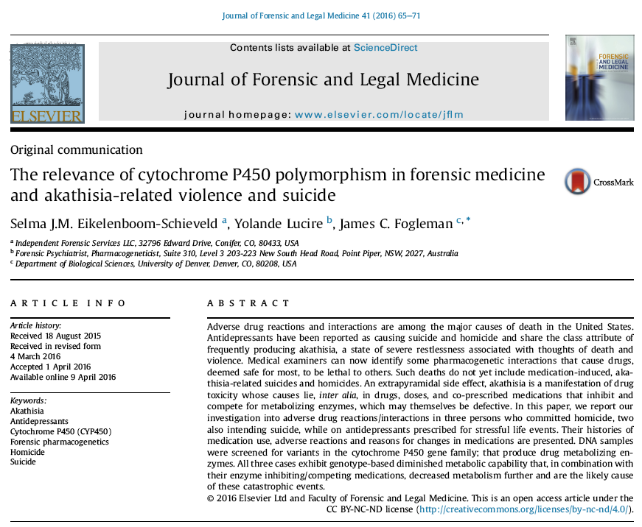

Slide 70
THE RELEVANCE OF PHARMACOGENETICS TO MEDICATION-INDUCED DEATH, SUICIDALITY & VIOLENCE
Adverse drug reactions and interactions are the second highest cause of death in USA. Sublethal ADRs fill hospital beds.
Pharmacogenetics takes knowledge of adverse drug reactions from the general to the particular.
Hundreds of home medication review trained pharmacists use this discipline every day in Australia.
Psychiatry treats new knowledge like medicine treated Semmelweis, Pasteur, and Warren & Marshall.

Slide 71
Three antidepressant-induced homicides
On multiple drugs
with multiple genetic problems.
All got antidepressants for psychosocial distress of a kind that does not lead to suicide or homicide.
Three killed others and two of them tried to kill themselves as well.
Murder suicide is very common in akathisia, which should always be suspected in such cases.
New issue: Charted, looking at the drugs, the doses, the prescribing order, and the combinations to identify diminished and further diminished metabolism.

Slide 72
We suggest that charting drugs, combinations and genotypes and phenotypes shows how metabolism is incrementally diminished.
Can be applied to the investigation of such cases.

Slide 73
39-YEAR-OLD WOMAN; VERY POOR METABOLIZER (CYP2D6*5/*41, CYP2C9*1/*1, CYP2C19*2/*17, AND CYP3A4*1/*22). MARITAL DISTRESS
Zolpidem 10 mg/night for insomnia.
Divorced, mother died. Sad.
Sertraline, 50 mg/day continuing long-term zolpidem.
Deteriorated, felt like a zombie; restless, sleepless and agitated.
Venlafaxine 150 mg/day. (3-6 X standard starting dose).
Developed an euphoric homicidal delirious state with altruistic belief that killing her husband and herself was somehow right for her children
Stopped venlafaxine abruptly.
Next day, ambushed her husband with a baseball bat and stabbed him many times.
Suicidal, overdosed on zolpidem and alcohol.

Slide 74
Genotype | In vitro activity | Gene-drug, drug-gene and drug-drug interactions | Phenotype
CYP2D6*5/*41 | *5 gene deletion *41 diminished | venlafaxine is both a substrate and inhibitor of CYP2D6, which is genetically compromised | further diminished activity, possibly no activity
CYP3A4*1/*22 | *1 normal *22 diminished | desvenlafaxine, sertraline, and zolpidem are substrates of CYP3A4 and compete for the enzyme, which is inhibited by sertraline | further diminished activity by inhibition and competition
CYP2C9*1/*1 | normal | zolpidem, sertraline, and venlafaxine are substrates of CYP2C9 and compete for the enzyme, which is inhibited by venlafaxine | diminished activity by inhibition and competition
CYP2C19*2/*17 | *2 inactive *17 ultra rapid | zolpidem, sertraline, and venlafaxine are substrates of CYP2C19 and compete for the enzyme, which is inhibited by sertraline | further diminished activity by inhibition and competition

Slide 75
Zolpidem (Sub Inh CYP1A2, Sub Inh CYP2C9, Sub CYP2C19, Sub Inh CYP2D6, Sub CYP3A4/5) is a self- and pan inhibitor suitable only for short-term use.
Substrate, sertraline (Sub CYP1A2, Sub Inh CYP2B6, Sub Inh CYP2D6, Sub Inh CYP2C9, Sub Inh CYP3A4) was added to an inhibitor, which provoked psychic numbing and worsening depression.
Venlafaxine and desvenlafaxine are metabolized by CYP2D6 and CYP3A4. Both genes were compromised.
Zolpidem and venlafaxine have the same ADRs, (Inc. homicide) so there was cumulative and synergistic toxicity.
Euphoric-homicidal delirium.
She stopped venlafaxine without tapering, and the rapid drop coincided with an altruistic homicide.
Five days later: no venlafaxine in blood.
5 half lives=72 hours

Slide 76
Personalized Medicine leads to Personalized Justice. (Our Editorial).
Forensic pharmacogenomics assists courts.
Defence of medical negligence cases. Drug companies do not warn.
Suicide in a toxic state is an accident for insurance purposes.
Toxic homicide: defense of perpetrators:
– involuntary intoxication
– non-insane automatism
Compensation to survivors.
Drug companies pay damages to:
Families of victims of homicide.
To survivors after suicide of breadwinners.

Slide 77
William Osler said: "Listen to your patient, he is telling you the diagnosis.” Ovid said: “Medicine sometimes snatches away health and sometimes gives it.”

Slide 78
Drugs as diverse as these in structure and function as all induce suicidal and homicidal thinking as an occasional side effect
Amphetamines
hypericum, (St John's Wort,)
varenicline (Chantix®),
oseltamivir (Tamiflu®),
Champix, Isotretinoin, Roaccutaine®) tetracyclines,
mefloquine (Lariam®),
metoclopramide (Maxolon® Reglan®),
zolpidem (Stilnox,® Ambien®),
calcium channel blockers,
antiepileptic drugs, some mooted as ‘mood stabilizers,
ADHD medicines’
allergy medicines,
reserpine,
benzodiazepines,
statins and interferon,
Moore et al. identified 1527 cases of violence including homicides disproportionally reported to the US FDA for 31 drugs, including varenicline, 11 antidepressants, 6 sedative/hypnotics and 3 drugs for attention deficit hyperactivity disorder.

Slide 79
33-year-old woman (CYP2D6*2/*2, CYP2C9*1/*3 (IM), CYP2C19*1/*1, CYP3A4*3/*22 (IM), CYP2C9 (IM), (also compromised at CYP3A4) became preoccupied with death.
Sertraline, then temazepam + quetiapine for insomnia.
Mood swings, panic attacks, suspicions, fatigue and weird thoughts, fluctuating with stress.
Venlafaxine 150 mg/day. “Erratic” and “chaotic.” Reduced to 75 mg/day. Temazepam and quetiapine ceased.
Stopped venlafaxine.
Fortnight later, resumed prescribed dosage.
Suffocated her 2 year old son & woke her 7-year-old-daughter.
Declared: “We all must die.”
Drove the car into a canal.

Slide 80
SUBJECT 2 GENOTYPES AND PHENOTYPES
Genotype | In vitro activity | Gene-drug, drug-gene and drug-drug interactions | Phenotype
CYP2D6*2/*2 | *2 usually extensive, but with some allelic variants | venlafaxine is a substrate of CYP2D6, which it also inhibits | diminished activity by inhibition and competition
CYP2C9*1/*3 | * active *3 inactive | venlafaxine is a substrate of CYP2C9 | diminished activity
CYP2C19*1/*1 | normal | CYP2C19 | normal activity for venlafaxine but little if any activity for desvenlafaxine
CYP3A4*3/*22 | *3 diminished *22 diminished | desvenlafaxine and venlafaxine are substrates for CYP3A4 which is inhibited by venlafaxine | further diminished activity by inhibition and competition, possibly no activity
Blood toxic level 2.29 mg/L combining venlafaxine: 0.59 mg/l
and desvenlafaxine: 1.7 mg/l.

Slide 81
Subject 2
Sertraline (Sub CYP1A2, Sub Inh CYP2B6, Sub Inh CYP2C9, Sub Inh CYP2D6, Sub Inh CYP3A4);
Temazepam (Sub CYP2C9, Sub CYP2C19, Sub CYP3A4).
Quetiapine (Sub CYP2C19, Sub Inh CYP2D6, Sub CYP3A4/5/6/7) all interacted, prolonging half-life.
Over time, sertraline inhibited and used up her defective CYP2C9, while sertraline and quetiapine used up and inhibited CYP2D6, leaving her with little or no enzymatic capacity.
Venlafaxine added a substrate to an inhibitor of CYP2D6, elevated blood levels, & caused ADRs so she stopped then restarted it.

Slide 82
42, (CYP2D6*2/*9, CYP2B61/*6, CYP2C9*1/*1, CYP2C19*6/*17, CYP3A4*1/*1) unfaithful wife, who refused to speak to him.
Paroxetine 20 mg/day, which he took intermittently.
Drank 12 beers & took 40 mg/paroxetine and used inhaler budesonide/formoterol.
Witnesses said he was neither drunk nor aggressive.
He drove to the rival’s house, & saw his estranged wife’s car.
Said his “lights went out.” (Psychological blow).
He fetched an antique revolver, smashed their window and “felt nothing” and was “like a robot.”
He forced entry & shot both of them, killing his wife. His rival survived.
Shaking, hot and cold, he drove for hours before turning himself in.
He reported that he could see them inside. Police said blinds were closed, suggesting he may have hallucinated.

Slide 83
SUBJECT 3 - GENOTYPE TO PHENOTYPE
Genotype and | -in vitro Activity | Gene-drug, drug-gene and drug-drug interactions | Phenotype
CYP2D6*2/*9 | *2 active *9 diminished | paroxetine is a substrate of CYP2D6 and inhibits it strongly; formoterol competes for CYP2D6 | further diminished activity by inhibition and competition
CYP2B6*1/*6 | *1 active *6 diminished | paroxetine and alcohol both inhibit CYP2B6 | further diminished activity by inhibition
CYP2C9*1/*1 | normal | paroxetine and alcohol inhibit CYP2C9; formoterol is a substrate | diminished activity by inhibition and competition
CYP2C19*6/*17 | *6 no activity *17 ultrarapid | paroxetine and alcohol inhibit CYP2C9; formoterol is a substrate | further diminished activity by inhibition and competition
Dried blood on the broken window showed paroxetine.

Slide 84
Paroxetine (Inh 1A2, Inh 2C9, Inh 2C19, Sub Inh 2D6, Inh 3A4) converts 80 per cent of EMs into PMs over time. 2D6 already compromised.
Paroxetine inhibits CYP1A2, CYP2C19 and CYP3A4. CYP3A4 was inhibited by paroxetine and also by the alcohol.
Alcohol on its own had not caused violent behavior before.
Hot and cold sensations, hallucinations, homicidal behavior and restless driving consistent with acute akathisia and serotonin toxicity.

